Slide 1

Global EV Sales 2010 - 2024
Presented By:
M. Kushal Virendra Chowdary
Batch No: 436

Slide 2
About me
I am a recent B.Tech graduate in Artificial Intelligence and Data Science from Vignan Institute of Technology and Science.
As an AI & DS student, I have the passion and interest to learn Data Science and apply it to solve real-world problems
LinkedIn - https://linkedin.com/in/kushal-manduri
GitHub - https://github.com/kushal1989

Slide 3


Table of Contents
Problem statement
Objectives of the Project
Data Understanding
Data Preparation & Steps Followed
DAX Measures
Final Dashboard Preview
Business Insights & Report
Challenges Faced
Conclusion
Q&A

Slide 4

Problem statement
The global shift toward electric vehicles (EVs) is accelerating, but adoption patterns vary widely across regions, vehicle categories, powertrain technologies, and economic groups.
Businesses, policymakers, and mobility planners lack unified visibility into where EV growth is strongest, which technologies are leading, how infrastructure is scaling, and what future demand may look like.
Without these insights, it becomes difficult to make
informed decisions about:
        Market expansion strategies
        Investment in charging infrastructure
        Powertrain development priorities
        Policy planning and sustainability goals

Slide 5
Objectives of the Project
The objective of this project is to analyze global Electric Vehicle (EV) adoption trends from 2010–2024 and provide data-driven insights that support strategic decision-making for businesses, policymakers, and mobility planners. Specifically, the project aims to:
1. Identify regional differences in EV adoption
2. Analyze EV growth across vehicle categories and transport modes
3. Compare powertrain adoption trends
4. Evaluate key EV-related performance parameters
5. Perform time-series and year-over-year trend analysis
6. Provide actionable insights for strategic planning

Slide 6


Data Understanding
Column Name | Type | Description | Values
Region | Text | The country for which EV data is reported. | Country names (e.g., China, India, USA)
Category | Text | Indicates whether the data is historical or belongs to a future projection scenario. | Historical, Projection-STEPS, Projection-APS
Parameter | Text | Describes the specific EV-related metric being measured. | EV stock, EV sales, charging points, etc.
Mode | Text | Refers to the type of vehicle represented in the record. | Cars, Buses, Vans, Trucks
Powertrain | Text | The EV technology or charging type in the dataset. | BEV, EV, PHEV, FCEV, Publicly Fast/Slow
Year | Whole Number | The year to which the recorded value corresponds. | Whole numbers (2010–2024)
Unit | Text | The unit used to measure the metric in the dataset. | Vehicles, %, GWh, charging points, etc.
Value | Decimal Number | The numeric value of the measured parameter. | Numeric values depending on parameter

Slide 7

Data Preparation & Steps Followed
1. Removed Non-Country Regions (World, Rest of World)
These are aggregated values that include all countries.
Keeping them would double-count totals and distort regional comparisons.
2. Removed Years Outside 2010–2024
Dataset included projection years and years outside the
stated range.
Removing unwanted rows ensured accurate
historical analysis and consistency with the project timeline.
3. Created transport_type (Passenger vs Freight)
Needed to compare EV adoption across transport purposes.
Passenger modes (Cars, Buses) vs Freight modes (Trucks).
4. Created Developed vs Developing Country Classification
Helps analyze EV adoption across economic groups.
Provides clearer insights into market maturity, sales growth, and infrastructure differences.

Slide 8

Final Dashboard Preview

Slide 9
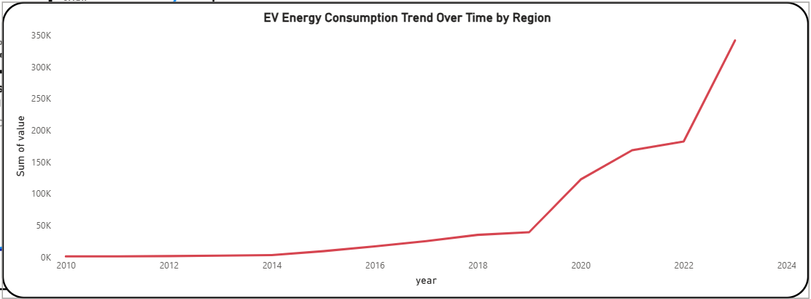
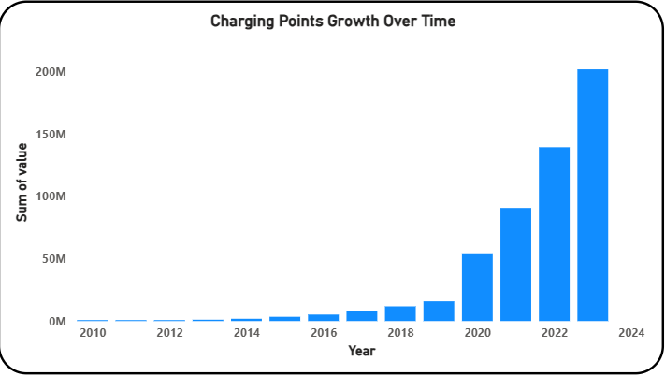
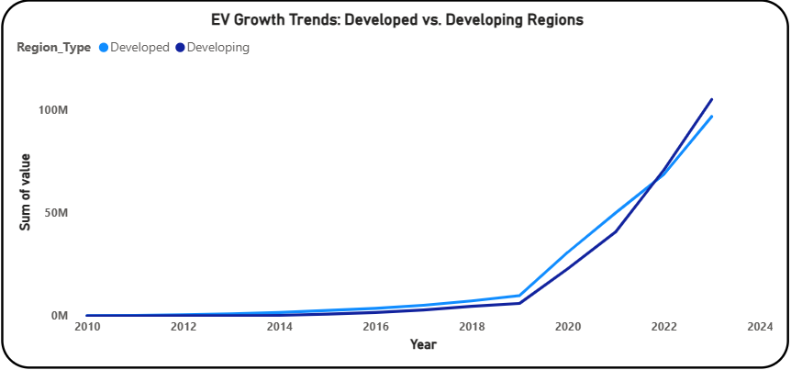
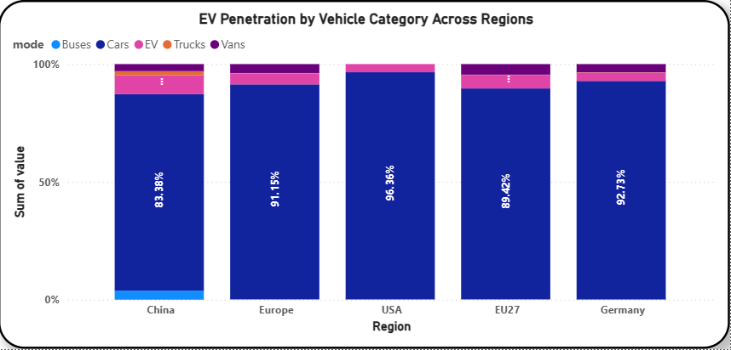
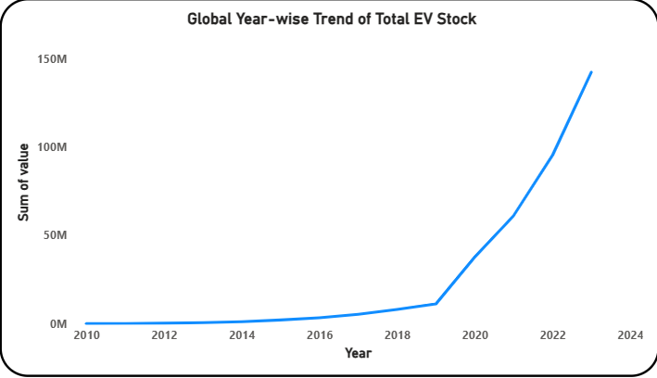
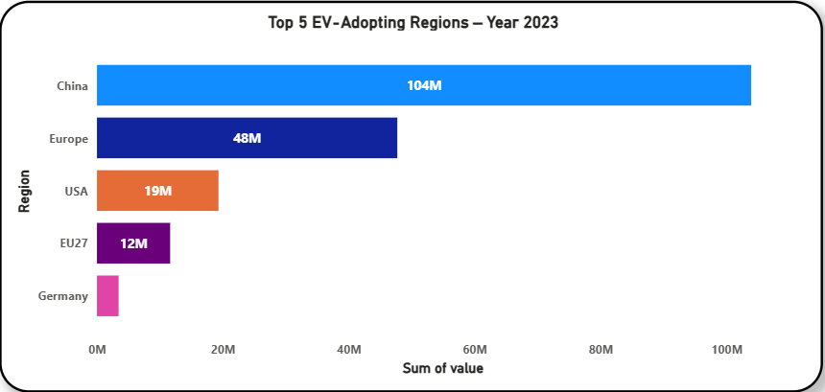
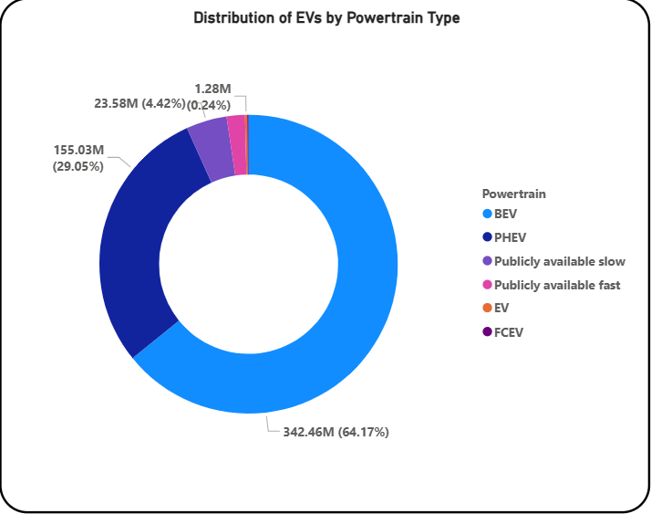
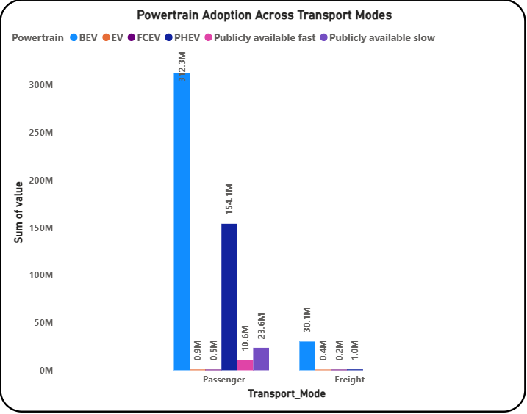
Business Insights
1. China leads global EV adoption by a significant margin.
2. Passenger vehicles dominate EV adoption compared to freight transport.
3. BEVs (Battery Electric Vehicles) are the most widely adopted powertrain.
4. Developed countries show faster and more consistent EV adoption.
5. Charging infrastructure is expanding rapidly, enabling BEV growth.
6. EV stock show exponential growth after 2017.
7. Electricity demand from EVs is rising sharply.
8. Vehicle mode and region combinations reveal large adoption disparities.

Slide 10
Challenges
1. Limited Dataset Coverage
The dataset lacked complete information for many countries and modes, limiting deeper regional analysis.
2. Skewed Distribution Across Regions
Some regions (like China and Europe) had very high data volume, while others had minimal values, making comparisons uneven.
3. Lack of Granular Data
Only yearly values were available, restricting detailed time-series analysis and short-term trend identification.
4. Multiple Units and Parameters
A single dataset contained inconsistent measurement units and varied EV metrics, complicating visual creation and interpretation.
5. Parameters with Same Units but Different Meaning
Metrics like EV stock and EV sales both used “vehicles” but represented different concepts, increasing the risk of misinterpretation.

Slide 11
Conclusion
Global EV adoption is rising rapidly, led by China, Europe, and the USA. Passenger cars and BEVs dominate growth, while commercial and freight electrification still lags behind. Developed countries show faster EV penetration due to strong policies and infrastructure support. EV stock, sales, and electricity demand have shown sharp upward trends after 2017, although adoption remains uneven across regions and vehicle modes.
Suggestions
To accelerate EV adoption, focus should be placed on electrifying commercial vehicles, expanding charging infrastructure—especially in developing regions—and strengthening policy support. Increasing renewable energy capacity is essential to meet rising electricity demand. Region-specific strategies, improved affordability, and continuous monitoring of EV trends will further support a smooth and sustainable transition to electric mobility.

Slide 12


Slide 13

THANK YOU

